Slide 1

TARP (Technical Answers for Real World Problems)
CSI3901
Final Review

Slide 2

Team Members
NAME Register No.
Aman Kumar 20MID0133
Sumail Alam 20MIC0027
Omkar Santaji Jadhav 20MIC0056
Vishal Maheshwari 20MIC0128
Saksham Jain 20MIC0003

Slide 3
Autism Detection using Deep Learning
Autism Spectrum Disorder (ASD) is a complex developmental condition that affects how people interact, communicate, and behave. Early diagnosis and intervention are crucial for improving outcomes for individuals with ASD. Recent advances in artificial intelligence, particularly deep learning, have shown potential in assisting with early ASD identification. Deep learning models can analyze large datasets of behavioral, medical, and genetic information to identify patterns that may indicate ASD. This approach has the potential to improve our understanding of ASD and lead to more accurate and efficient diagnostic tools. However, it is important to consider interdisciplinary collaboration, ethical considerations, and ongoing refinement of these innovative approaches.

Slide 4
Understanding Autism Spectrum Disorder
Autism Spectrum Disorder (ASD) is a
complex neurodevelopmental
condition characterized by challenges
with social interaction, communication,
and repetitive behaviors. Early
detection and intervention are crucial
for improving outcomes and quality of
life for individuals with ASD.

Slide 5
Challenges in Autism Diagnosis
clinical observation and
subjective assessments, leading to
variability and potential biases in
diagnosis. There is a critical need for
more objective and accurate
diagnostic tools to improve early
intervention and support.
Current methods for autism diagnosis
rely heavily on

Slide 6
Procedure
Data Collection:
Gather diverse datasets, including behavioral, medical, and genetic information related to autism.
Data Preprocessing:
Clean and standardize data, handling missing values and ensuring accurate labels.
Feature Extraction:
Extract relevant features from the data to input into the deep learning model.
Model Selection:
Choose a suitable deep learning architecture (e.g., CNNs, RNNs) based on the nature of the data.
Model Training:
Train the selected model using preprocessed data, adjusting parameters to minimize prediction errors.

Slide 7
Procedure
Validation and Testing:
Validate the model's performance on a separate dataset, then test it on new, unseen data.
Hyperparameter Tuning:
Fine-tune model hyperparameters to improve accuracy and generalization.
Interpretability and Explainability:
Ensure the model's decisions are interpretable, crucial for medical applications.
Ethical Considerations:
Address privacy concerns and potential biases in the data; obtain ethical approvals.
Continuous Improvement:
Iterate on the model based on feedback and emerging data, ensuring ongoing refinement.

Slide 8
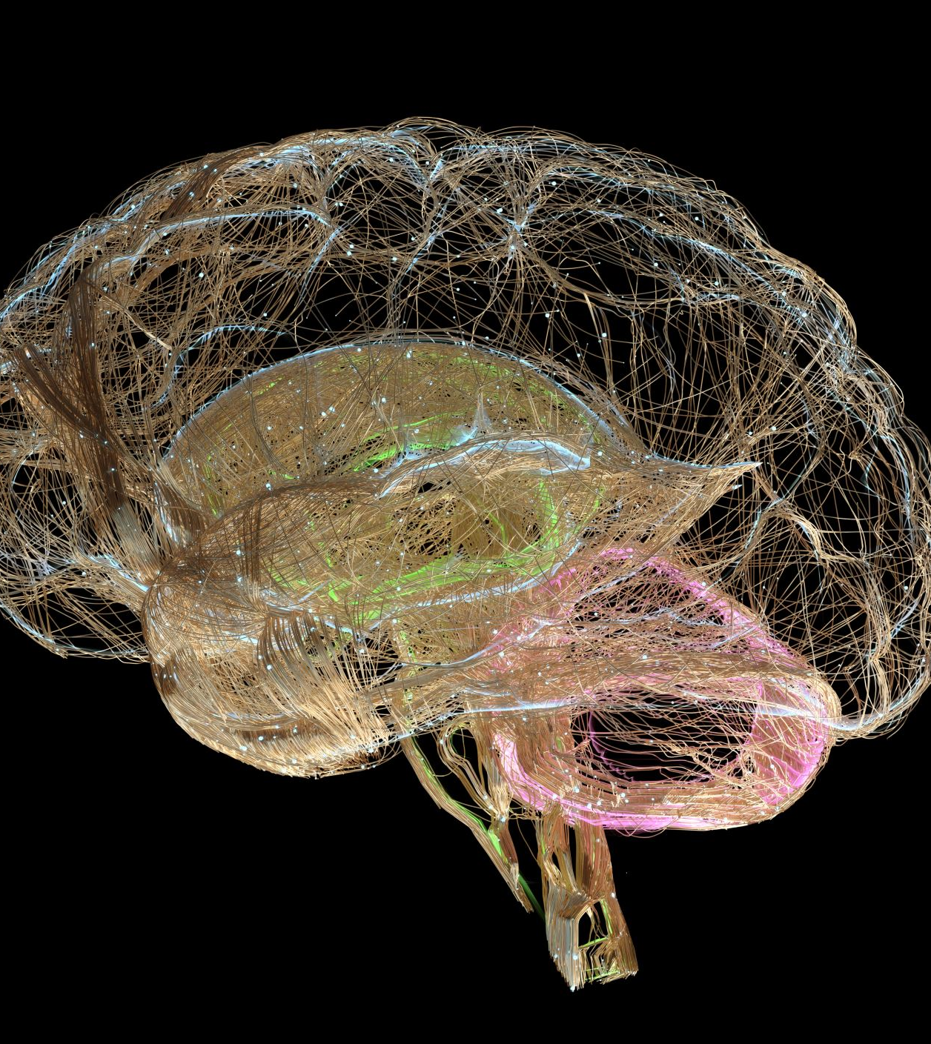
CNN
Inspired by the visual cortex of the human brain
Can learn to recognize patterns in images
Used in a variety of applications, including image classification, object detection, and image segmentation

Slide 9
Working
Convolutional Neural Networks (CNNs) are a type of deep learning model commonly used for image classification and recognition tasks. They are designed to automatically learn and extract meaningful features from images.
One of the key components of CNNs is the convolutional layer. Convolutional layers apply a set of learnable filters to the input image, performing a convolution operation. This operation involves sliding the filters over the image and computing the dot product between the filter weights and the corresponding pixels in the input. The result is a feature map that represents the presence of specific features or patterns in different regions of the image.
After the convolutional layer, pooling layers are typically used to reduce the dimensionality of the data. Pooling involves dividing the feature map into non-overlapping regions and taking the maximum or average value within each region. This downsampling operation helps to reduce the spatial size of the feature map while preserving the most important information.
Finally, fully connected layers are employed to make predictions based on the extracted features. These layers connect every neuron in one layer to every neuron in the next layer, allowing for complex relationships to be learned. The output of the fully connected layers is passed through a softmax activation function to generate the final probabilities for different classes or labels.
By combining convolutional layers

Slide 10
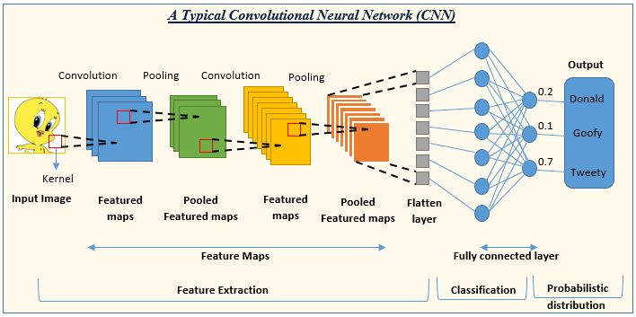

Slide 11
CNN ARCHITECTURES
LeNet-5:
One of the early CNN architectures, designed for handwritten digit recognition. It consists of convolutional layers followed by fully connected layers.
AlexNet:
A deeper architecture that gained prominence for winning the ImageNet Large Scale Visual Recognition Challenge. It includes multiple convolutional and pooling layers.
VGGNet:
Known for its simplicity, VGGNet has a uniform architecture with small 3x3 convolutional filters stacked on top of each other.

Slide 12
GoogLeNet (Inception):
Introduces the concept of inception modules, which use multiple filter sizes in parallel to capture features at different scales.
ResNet (Residual Network):
Addresses the challenge of training very deep networks by introducing skip connections, allowing the model to skip one or more layers.
DenseNet:
Maximizes information flow through the network by connecting each layer to every other layer in a feed-forward fashion.
MobileNet:
Optimized for mobile and edge devices, MobileNet uses depthwise separable convolutions to reduce the number of parameters.
EfficientNet:
A family of models that scale the model's depth, width, and resolution to achieve better performance with fewer parameters.

Slide 13
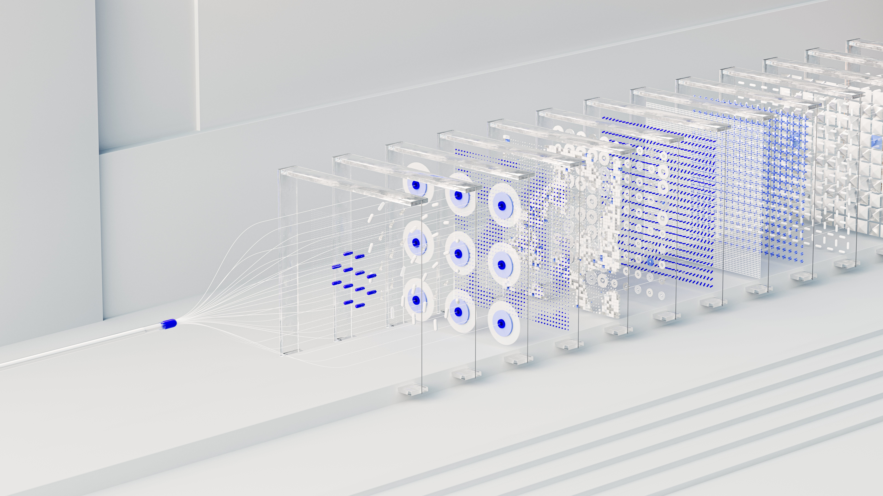

Slide 14

Nature Of Dataset
Audio recordings
Video recordings
images

Slide 15
Proposed solution : A multimodal Solution GITHUB LINK
Early Fusion:
Combine features from different modalities at the input level and feed them into a unified model. For example, concatenate features from audio, video, and images and input them into a CNN or a hybrid model.
Late Fusion:
Train separate models for each modality and combine their outputs at a later stage. This can involve merging the results from individual models using a fusion layer or combining predictions at the decision level.
3D CNNs (for video data):
If your video recordings are in the form of sequences, 3D CNNs can capture temporal dependencies in the data. This is particularly relevant if there are patterns in motion or changes over time that are indicative of autism.
Audio Processing Models:
Use models designed for audio data to analyze the acoustic features of the recordings. Recurrent Neural Networks (RNNs) or Convolutional Neural Networks (CNNs) with spectrogram inputs are common in audio processing tasks.
Image Processing Models:
Leverage CNNs for image data. If there are specific visual patterns in the images related to autism, a well-designed image processing model (like VGGNet, ResNet, or DenseNet) can be effective.
Multimodal Architectures:
Explore architectures specifically designed for multimodal data, combining both spatial and temporal aspects. Models like Late Fusion Attention Network (LFAN) or Multimodal Compact Bilinear Pooling (MCB) can handle diverse types of data.
Attention Mechanisms:
Incorporate attention mechanisms to let the model focus on specific parts of each modality that are most informative for the task.

Slide 16


Slide 17
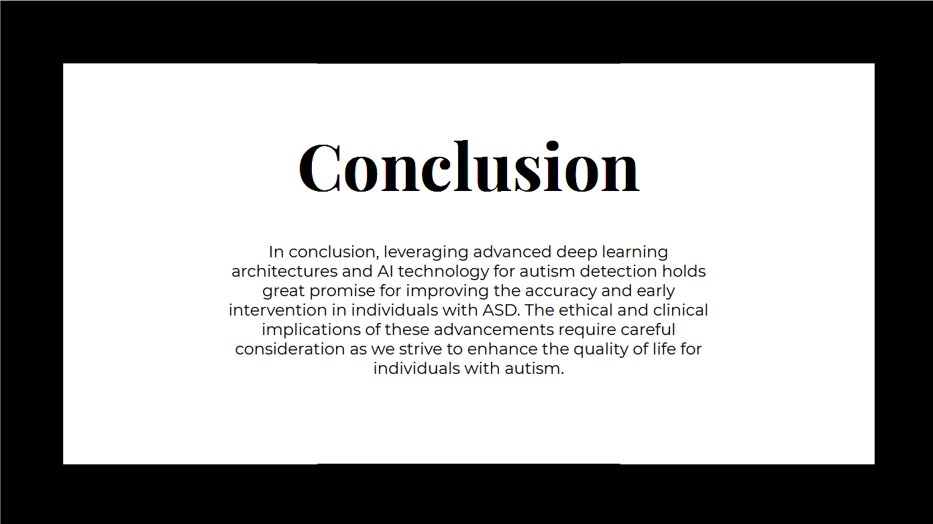

Slide 18
ThankYou

